Slide 1

Stage 3
Negative Space
Course Designer: Eric Beerbaum
Negative Space is a 20 round, 100 point Comstock medium course. There are 8 USPSA targets and 4 steel targets. The best two hits per target will score. The start signal is audible
The Handgun start position is inside the shooting area, heels touching Xs, handgun loaded and holstered, wrists below belt.
The PCC start position is inside the shooting area, heels touching Xs, PCC loaded, stock on belt, muzzle generally downrange.
On the audible start signal, engage targets as they become visible.
Notes:
‹#›
‹#›

Slide 2
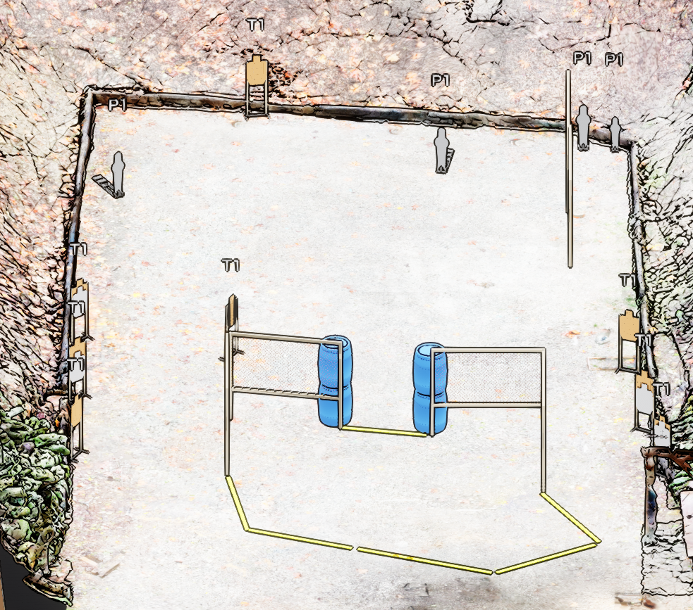
Stage 3
Negative Space
Course Designer: Eric Beerbaum

